Slide 1
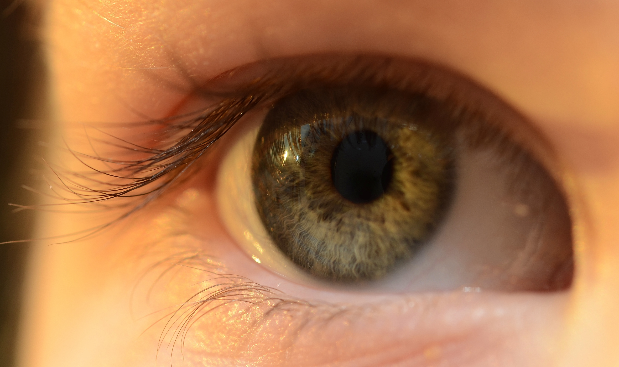
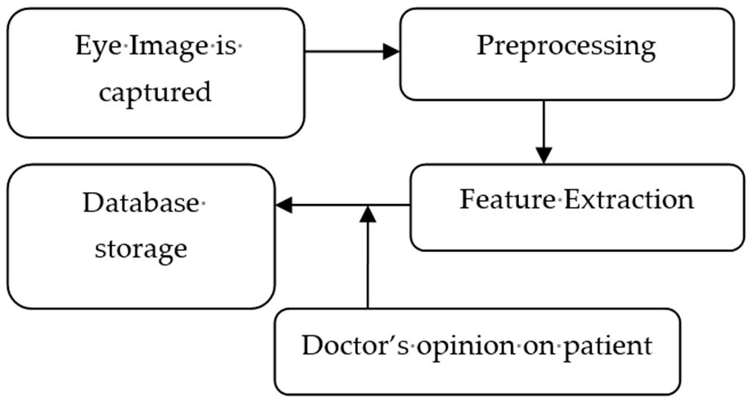

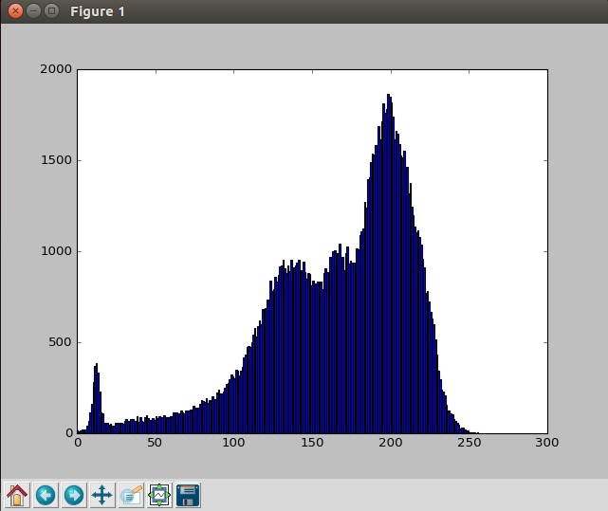
Cataract Detection
Sagar Kumar Singh
Anurag Nidhi
IIT - BHU
Introduction
Methods
Algorithm
Results & Conclusions
References
Cataract is one main causes of the blindness in India. But it’s diagnosis and detection takes both time and money. This project is to detect the cataract problem in the eyes with just an image from your mobile. This method commercializes the detection and identification of this disease in an individual with the use of various image processing and machine learning techniques.
Eye related disorders and subsequent vision loss affects individuals severely through on-going medical expenses during treatment of disorders and through the high economic and mental trauma of degrading vision.
The computer aided cataract detection use retinal, ultrasound or slit lamp images. These systems have increased complexities, and the cost of acquisition module is very high. These devices require a trained technician for its operation.
Development of a low cost system can be accomplished by using digital camera images. These devices are very common and images acquired by them need just a few instructions to be followed to be used in a system
developed to detect cataracts based on these true color images.
The
basic method proposed for robust cataract detection algorithm can be described in three steps:
1. Preprocessing
2. Feature extraction
3. Decision making.
Image preprocessing which includes reading true color image, its conversion to grayscale image, contrast enhancement, noise removal using Gaussian filter, cropping the pupil area from the eye image, resizing the cropped image to 256 × 256 pixels size and histogram calculation.
The next step is calculation of feature parameter:
Feature extraction is done after preprocessing to extract all the information for cataract detection and grading from the circular pupil region. The proposed detection algorithm is based
on finding the accurate thresholds of texture feature parameters such as image intensity (I), standard deviation (s), to distinguish between healthy and abnormal eyes. In cataract eyes, the whitish color originates from the lens region so it can be easily concluded
that cataract eyes have higher intensities than normal eyes.
Decision making after comparing these feature parameter values from thresholds.
The Method to use it :
Just take a pic from your phone of the eye to be tested.
Crop the image of eye pupil(the black color of the eye).
Run the app.
That’s it!!
It will produce the result showing you the
The Histogram of your eye.
The histogram of the healthy eye.
Classification of your eye as a cataract or a healthy eye.
The proposed algorithm detects presence of cataract by reading texture information from circular pupil of adult human subjects.
It is a texture information based automated algorithm for detection of cataracts from a digital eye image of adult human subjects.
Future work includes fine tuning of the threshold parameters for cataract detection by considering a large number of patients and corresponding ophthalmologists’ decisions. Intelligent computing methods such as SVM or machine learning can be used for improved results.
Yang, J.-J.; Li, J.; Shen, R.; Zeng, Y.; He, J.; Bi, J.; Li, Y.; Zhang, Q.; Peng, L.; Wang, Q. Exploiting ensemble learning for automatic cataract detection and grading.
Shen, H.; Hao, H.; Wei, L.; Wang, Z. An image based classification method for cataract. In Proceedings
of the International Symposium on Computer Science and Computational Technology.
Nayak, J. Automated classification of normal, cataract and post cataract optical eye images using SVM classifier.
TEMPLATE DESIGN © 2008
www.PosterPresentations.com

